Slide 1


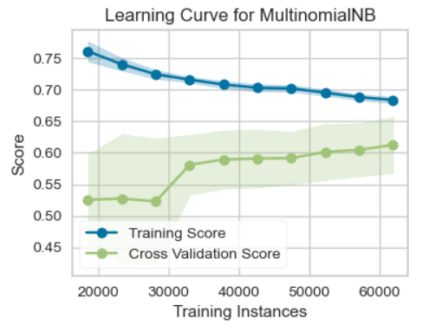
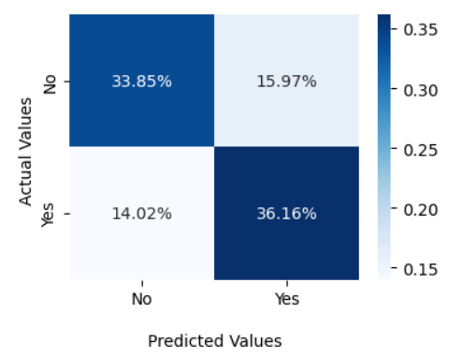
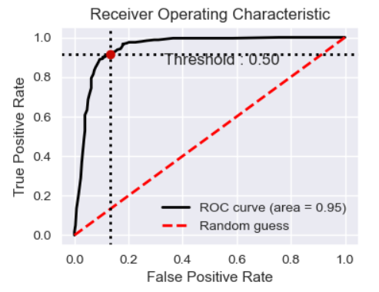
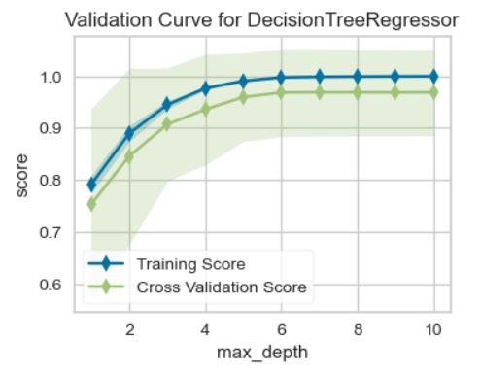
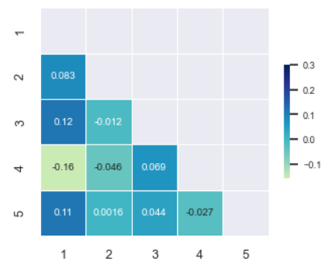
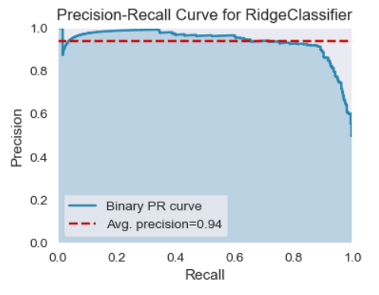
ML Visualization Cheat Sheet
Tools
Classification
With the help of following Python libraries, it makes it possible to understand ML data with statistics
LEARNING CURVES
DO WE HAVE ENOUGH DATA?
CONFUSION MATRIX
WHICH CLASSES ARE MIXED-UP?
ROC CURVE
IS CLASSIFIER A GOOD RANKER?
YELLOWBRICK
• For Learning Curve:
from yellowbrick.model_selection import learning_curve
• For Validation Curve:
from yellowbrick.model_selection import validation_curve
• For Precision-Recall Curve:
cm = confusion_matrix(y_test, y_pred)
sns.heatmap(cm/np.sum(cm),fmt='.2%', annot=True, cmap='Blues')
bc=BinaryClassification(y_test, y_pred, labels=[c1, c2])
bc.plot_roc_curve()
from yellowbrick.classifier import PrecisionRecallCurve
learning_curve(MultinomialNB(), X, y)
Where
MultinomialNB() – classifier of your choice
X, y – classification dataset
Where
y_test, y_pred – test set, training set
Where
y_test, y_pred – test set, training set
BinaryClassification() – classification of your choice
SKLEARN
VALIDATON CURVES
WHAT ARE THE OPTIMAL HYPERPARAMETERS?
CORRELATION MATRIX
HOW CORRELATED ARE PARAMETERS?
PRECISION-RECALL CURVE
WHAT IS THE PRECISION-RECALL TRADEOFF?
• For ROC Curve:
from sklearn.metrics import roc_curve
• For Confusion Matrix:
from sklearn.metrics import confusion_matrix
• For Precision-Recall Curve:
from sklearn.linear_model import LinearRegression
SEABORN
• For Confusion and Correlation Matrices:
validation_curve(DecisionTreeRegressor(), param_name="max_depth",
param_range=np.arange(1, 11))
mask = np.triu(np.ones_like(dataset, dtype=bool))
sns.heatmap(dataset, mask=mask, cmap="YlGnBu", annot=True, vmax=.3, center=0,
square=True, linewidths=.5, cbar_kws={"shrink": .5})
p = PrecisionRecallCurve(RidgeClassifier(random_state=0))
p.fit(X_train, y_train)
p.score(X_test, y_test)
import seaborn as sns
Where
DecisionTreeRegressor() – classifier of your choice
param_name – name of the varied parameter
Where
dataset – used dataset
Where
X_train, X_test, y_test, y_pred – test sets, training sets
CC BY Sofya Aksenyuk, Uladzimir Ivashka Updated: 2022-06

Slide 2
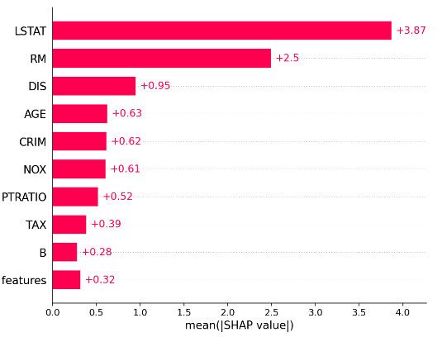
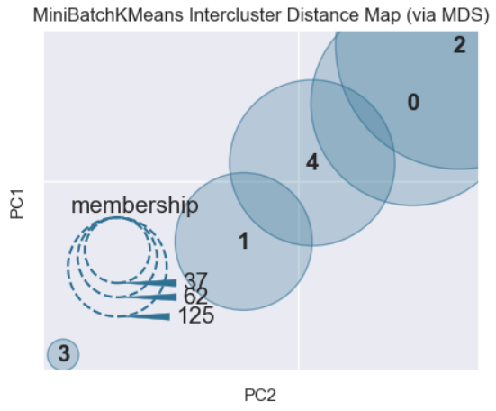
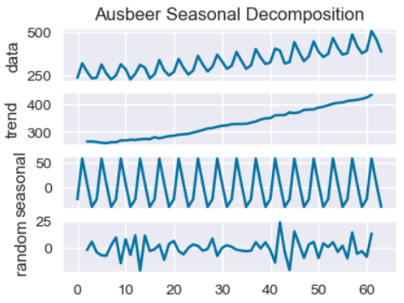
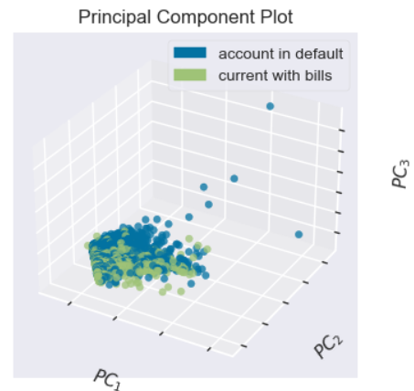
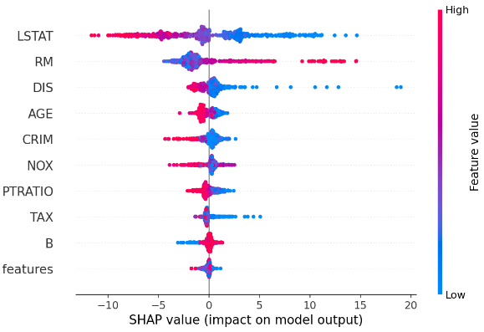
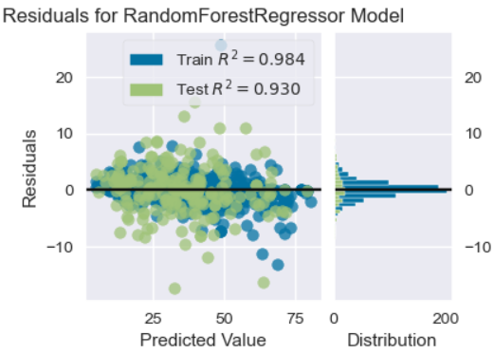

SHAP
Feature Analysis
Clustering
Regression & Time Series
• For Feature Importance Plot and
SHAP summaries:
FEATURE IMPORTANCE PLOT
MOST IMPORTANT PREDICTION FEATURES
INTERCLUSTER DISTANCE MAP
HOW DISTANT ARE THE CLUSTERS?
SEASONALITY DECOMPOSITION
SEASON, TRADE, NOISE IM TIME SERIES
import xgboost
import shap
X, y = shap.dataset
model = xgboost.XGBRegressor().fit(X, y)
explainer = shap.Explainer(model)
Where
model – an XGBoost model to train
X, y – a dataset to train
dataset – used dataset
YELLOWBRICK
• For Intercluster Distance Map:
from yellowbrick.cluster import intercluster_distance
shap_values = explainer(X)
shap.plots.bar(shap_values)
intercluster_distance(MiniBatchKMeans(5, random_state=777), X)
utils.decomposed_plot(decomposed, figure_kwargs=figure_kwargs, show=False)
• For Residuals Plot:
Where
shap_values – model’s prediction explanation
Where
MiniBatchKMeans – used algorithm
Where
decomposed – tuple of y-axis variable datasets
from yellowbrick.regressor import residuals_plot
SHAP SUMMARIES
FEATURE IMPORTANCES FOR EACH PREDICTION
PRINCIPAL COMPONENT PLOT
3D-LOOK OF DATASET
RESIDUALS PLOT
ARE REGRESSION ERRORS NORMALLY DISTRIBUTED?
• For Principal Component Plot:
from yellowbrick.features import PCA
PMDARIMA
• For Seasonality Decomposion:
from pmdarima import arima
from pmdarima import utils
USEFUL LINKS
shap_values = explainer(X)
shap.plots.bar(shap_values)
• SHAP
• YELLOWBRICK
• PMDARIMA
• SKLEARN
• SEABORN
residuals_plot(RandomForestRegressor(), X_train, y_train, X_test, y_test)
Where
shap_values – model’s prediction explanation
p = PCA(scale=True, projection=3, classes=classes)
p.fit_transform(X, y)
Where
X_train, X_test, y_test, y_pred – test sets, training sets
RandomForestRegressor() – estimator of your choice
Where
X, y – used dataset
classes – class labels
CC BY Sofya Aksenyuk, Uladzimir Ivashka Updated: 2022-06

